Slide 1


Slide 2

Public Health LO4-Week 1-Slide 2 Health Promotion

Slide 3

Aim;
Evaluates theories and approaches of health promotions relevant to health issues within professional roles or work placement.
Learning Outcomes;
Explore the definition of health
Review the historical development of health promotion theory and practice
Evaluate different strategies / approaches to health promotion
Created by Tayo Alebiosu

Slide 4

How do you define health?

Slide 5
The World Health Organization (WHO) defines health as 'a state of complete physical, mental and social wellbeing and not merely the absence of disease or infirmity'. – WHO Constitution
Health is a state of physical, mental and social well-being in which disease and infirmity are absent. A variety of definitions have been used for different purposes over time.

Slide 6
1948 WHO definition of health “A state of complete physical, mental and social well-being and not merely the absence of disease or infirmity” – WHO Constitution

Slide 7
Some factors affecting health are due to individual choices, such as whether to engage in a high-risk behaviour, and others are due to structural causes, such as whether the society is arranged in a way that makes it easier or harder for people to get necessary healthcare services. Still other factors are beyond both individual and group choices, such as genetic disorders.
Health can be promoted by encouraging healthful activities, such as regular physical exercise, and by reducing or avoiding unhealthful activities or situations, such as smoking or excessive stress.

Slide 8
1948 WHO definition of health “A state of complete physical, mental and social well-being and not merely the absence of disease or infirmity” – WHO Constitution

Slide 9
Health promotion
In 1984, the WHO defined health promotion as the process of enabling people to take control over maintaining and improving their health. With the issuance of this definition, a decade of focus on the impact of lifestyle on health shifted to attention on the structural factors in society that support health.
According to the World Health Organization (1986), "health promotion is the process of enabling people to increase control over, and to improve their own health." To bring this process and its desired outcomes to fruition, many theories and models for understanding and altering health behaviours have been designed and utilized.

Slide 10
Health promotion is the process of enabling people to increase control over, and to improve, their health.
It moves beyond a focus on individual behaviour towards a wide range of social and environmental interventions.
Health promotion is the process of improving and protecting the health of the public, including individuals, populations, and communities.
Health promotion is the process of enabling people to increase control over, and to improve, their health. ...
This is accomplished by building healthy public policies, creating supportive environments, and strengthening community action and personal skills.

Slide 11

Health promotion involves public policy that addresses health determinants such as income, housing, food security, employment, and quality working conditions.
More recent work has used the term Health in All Policies to refer to the actions that incorporate health into all public policies.
Health promotion is aligned with health equity and can be a focus of non-governmental organizations (NGOs) dedicated to social justice or human rights.
Health literacy can be developed in schools, while aspects of health promotion such as breastfeeding promotion can depend on laws and rules of public spaces.

Slide 12
How do we promote our physical, mental, emotional, social, and psychological wellbeing?
We promote through-----
Health Promotion programs

Slide 13

Understanding Health Promotion - A Short Introduction
https://youtu.be/y9THQTEqMaU
Idrentify health promotion strategies from the video clip
What is Health Promotion
https://youtu.be/60UXj6XjZMM

Slide 14
Introduction
A brief history of Health Promotion
Each period and accomplishment has helped delineate the depth and breadth of health promotion practice.
Although the latter part of the 20th century is typically viewed as being most critical in shaping the nature of health promotion practice.

Slide 15
This first publication of health promotion is from the 1974 Lalonde report from the Government of Canada, which contained a health promotion strategy "aimed at informing, influencing and assisting both individuals and organizations so that they will accept more responsibility and be more active in matters affecting mental and physical health".
Another predecessor of the definition was the 1979 Healthy People report of the Surgeon General of the United States, which noted that health promotion "seeks the development of community and individual measures which can help... [people] to develop lifestyles that can maintain and enhance the state of well-being.

Slide 16
The first International Conference on Health Promotion was held in Ottawa in 1986, and was primarily a response to growing expectations for a new public health movement around the world.
It launched a series of actions among international organizations, national governments and local communities to achieve the goal of "Health For All" by the year 2000 and beyond.
The basic strategies for health promotion identified in the Ottawa Charter were: advocate (to boost the factors which encourage health), enable (allowing all people to achieve health equity) and mediate (through collaboration across all sectors).

Slide 17
Since then, the WHO Global Health Promotion Conferences have established and developed the global principles and action areas for health promotion. Most recently, the 9th global conference (Shanghai 2016), titled ‘Promoting health in the Sustainable Development Goals:
Health for all and all for health’, highlighted the critical links between promoting health and the 2030 Agenda for Sustainable Development.
Whilst calling for bold political interventions to accelerate country action on the SDGs, the Shanghai Declaration provides a framework through which governments can utilize the transformational potential of health promotion.

Slide 18
The history of health promotion-Cont..
The Royal Society for Public Health was formed in October 2008 by the merger of the Royal Society for the Promotion of Health (also known as the Royal Society of Health or RSH) and the Royal Institute of Public Health (RIPH).
Earlier, July 2005 saw the publication by the Department of Health and Welsh Assembly Government of Shaping the Future of Public Health: Promoting Health in the NHS.
Following discussions with the Department of Health and Welsh Assembly Government officials, the Royal Society for Public Health and three national public health bodies agreed, in 2006, to work together to take forward the report's recommendations, working in partnership with other organisations

Slide 19
Examples of effective health promotion activities for child and family health
Promoting breastfeeding.
Promoting child and family nutrition.
SIDS prevention and education
Injury prevention
Promoting physical activity.
Smoking cessation programs such as 'quit' activities and 'brief interventions'

Slide 20
Aims of health promotion
Health promotion focuses on achieving equity in health.
Health promotion action aims at reducing differences in current health status and ensuring equal opportunities and resources to enable all people to achieve their fullest health potential.
Why is health promotion important?
Health promotion improves the health status of individuals, families, communities, states, and the nation.
Health promotion enhances the quality of life for all people.
Health promotion reduces premature deaths.

Slide 21
Health promotion Aims –cont….
Health promotion and disease prevention can be achieved through planned activities and programs that are designed to improve population health outcomes.
Health promotion and disease prevention programs can empower individuals to make healthier choices and reduce their risk of disease and disability.
At the population level, they can eliminate health disparities, improve quality of life, and improve the availability of healthcare and related services.
Health promotion programs can be implemented in varied settings, including rural communities.
Residents can benefit from health promotion and disease prevention programs scaled for use in communities, which have unique implementation considerations.

Slide 22
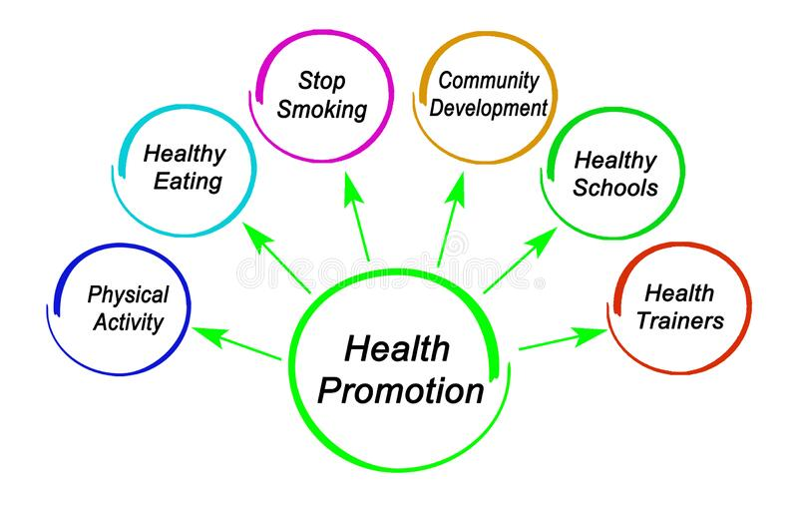
Health Promotion and Disease Prevention
Health promotion and disease prevention programs focus on keeping people healthy.
Health promotion programs aim to engage and empower individuals and communities to choose healthy behaviours, and make changes that reduce the risk of developing chronic diseases and other morbidities.
World Health Organization, defined health promotion:
“Enables people to increase control over their own health. It covers a wide range of social and environmental interventions that are designed to benefit and protect individual people’s health and quality of life by addressing and preventing the root causes of ill health, not just focusing on treatment and cure”.

Slide 23
Disease prevention & health promotion
Health promotion and disease prevention programs often address social determinants of health, which influence modifiable risk behaviours.
Social determinants of health are the economic, social, cultural, and political conditions in which people are born, grow, and live that affect health status.
Modifiable risk behaviours include, for example, tobacco use, poor eating habits, and lack of physical activity, which contribute to the development of chronic disease.
Sedentary lifestyle
A sedentary or inactive lifestyle. a lifestyle with a lot of sitting and lying down, with very little to no exercise. In the United States and around the world, people are spending more and more time doing sedentary activities.

Slide 24

Disease prevention & health promotion
Disease prevention differs from health promotion because it focuses on specific efforts aimed at reducing the development and severity of chronic diseases and other morbidities.
Wellness is related to health promotion and disease prevention.
Wellness is described as the attitudes and active decisions made by an individual that contribute to positive health behaviours and outcomes

Slide 25

Typical activities for health promotion, disease prevention, and wellness programs include:
Communication: Raising awareness about healthy behaviors for the general public. Examples of communication strategies include public service announcements, health fairs, mass media campaigns, and newsletters.
Education: Empowering behaviour change and actions through increased knowledge. Examples of health education strategies include courses, trainings, and support groups.
Policy, Systems, and Environment: Making systematic changes – through improved laws, rules, and regulations (policy), functional organizational components (systems), and economic, social, or physical environment – to encourage, make available, and enable healthy choices.

Slide 26
Reference

